Slide 1
August 9, 2021
Amsterdam Airbnb
Insights and Visualizations
With the ongoing feud between the Amsterdam government and Airbnb, how can hosts make sure to get the best out of their listing?
Avery Shepherd
Jacob Pammer
Kaushik Kumaran
Surya Pamireddygari
Vishu Agarwal

Slide 2
INTRODUCTION

Slide 3


The Problem

Slide 4
Steps to a solution
Data Cleansing
Exploratory Data Analysis
Models
Business Impact

Slide 5
Data
16724 rows of data with 16 variables
Variables | Description |  | Variables | Description
ID | Airbnb's unique identifier for the listing |  | Longitude | Uses the World Geodetic System (WGS84) projection for latitude and longitude.
Name | Name of the listing |  | Room Type | Entire apt, Private room, Shared room/Hotel
Host ID | Airbnb's unique identifier for the host/user |  | Price | Daily price in local currency
Host Name | Name of the host. Usually just the first name(s). |  | Minimum Nights | Minimum number of night stay for the listing (calendar rules may be different)
Neighborhood Group | Aggregation of small neighborhoods |  | Reviews per Month | The number of reviews the listing has over the lifetime of the listing
Neighborhood | Neighborhood corresponding to the listing |  | Availability 365 | The availability of the listing 365 days in the future as determined by the calendar.
Latitude | Uses the World Geodetic System (WGS84) projection for latitude and longitude. |  | Last Review | The date of the last/newest review
Calculated Host Listings Count | The number of listings the host has in the region |  | Number of Reviews | The number of reviews the listing has
Notes:
last_review
reviews_per_month
calculated_host_listings_count
The number of reviews the listing has over the lifetime of the listing
availability_365

Slide 6
Data Cleaning
Variable | Problem | Treatment
Reviews per month | Missing values | Replace with 0
Neighborhood Group | Whole column is blank | Remove the column
Price | Presence of outliers | IQR outlier treatment Lower bound : Q1 – 1.5 * IQR Upper bound : Q3 + 1.5 * IQR

Slide 7
EXPLORATORY DATA ANALYSIS

Slide 8
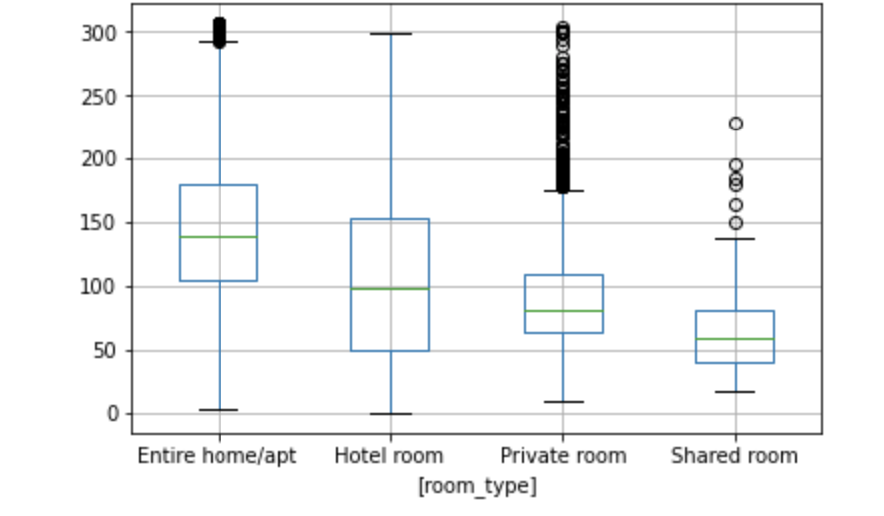
Listing Price seems to be largely driven by room type
Notes:
Price dependency on room type logically makes sense as well! An entire apartment is bound to cost more than a Private room!
Hence, to further explore the price dynamics among the listings, we will split the data into Entire Home/apartments vs. Others

Slide 9
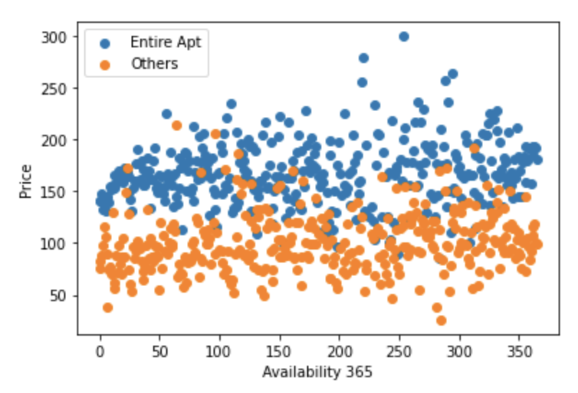
Future Availability does not seem to affect the price
Notes:
Listing availability 365 days in the future does not seem to have any impact on the price for both – Entire apartments and Private rooms

Slide 10
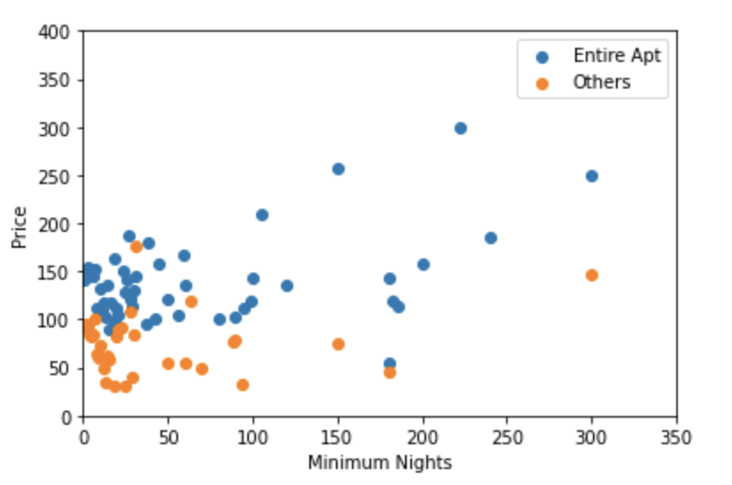
For entire apartments, minimum nights at a listing seem to have a positive association with price
Notes:
Entire Apartments : The longer the duration of minimum stay at an entire apartment listing, the greater was the price
Private Rooms : This trend does not seem to clearly reflect for Private rooms

Slide 11
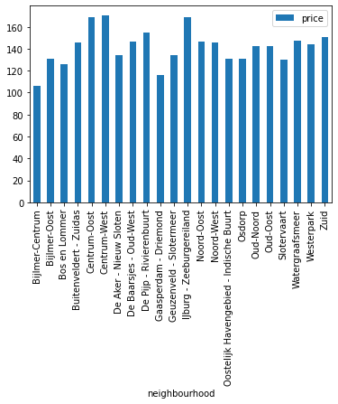
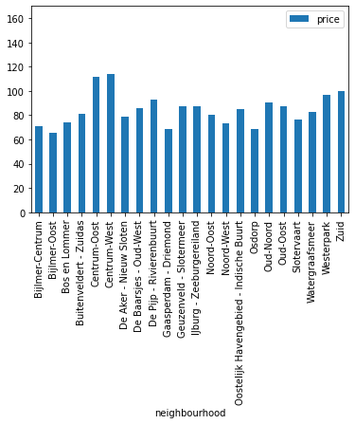
Prices are affected by neighborhood, across homes and rooms
Mean Price by Neighborhood for Entire Apt.
Mean Price by Neighborhood for Private Room
Notes:
Since the 4 out of top 5 neighborhoods for both kind of listings are similar (bit shuffled), we will use the overall top 5 neighbors for next few slides for simplicity!

Slide 12
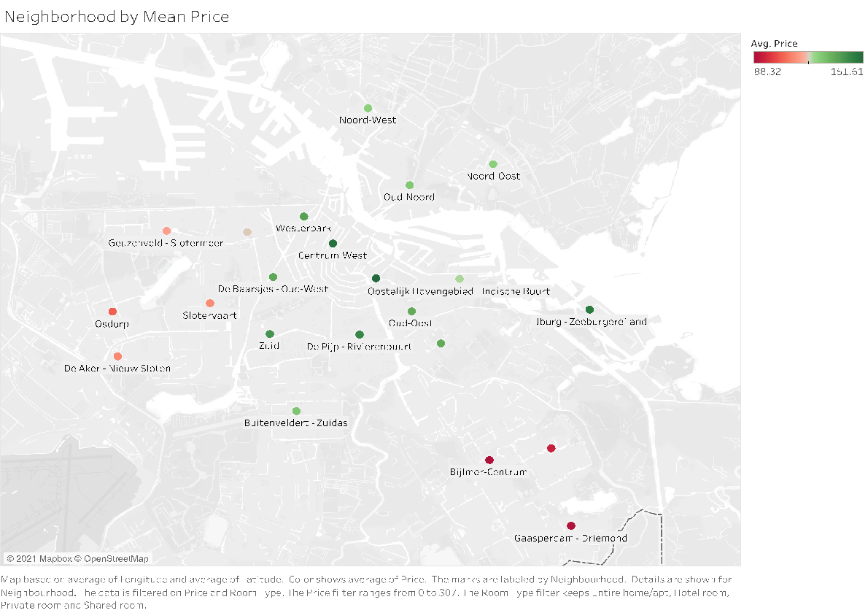
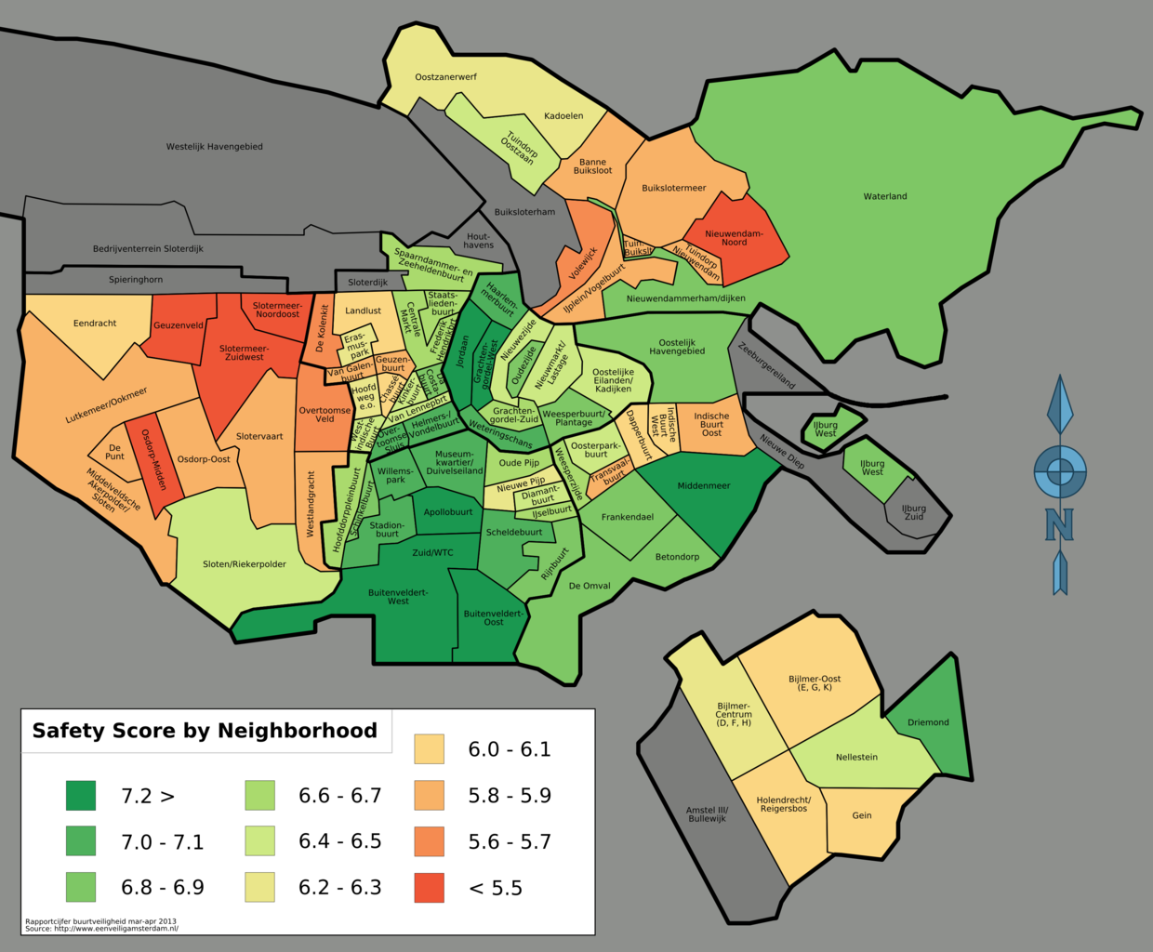
Explaining neighborhood price differentiation with safety
Mean Price Heatmap by Neighborhood
Safety Heatmap by Neighborhood

Slide 13
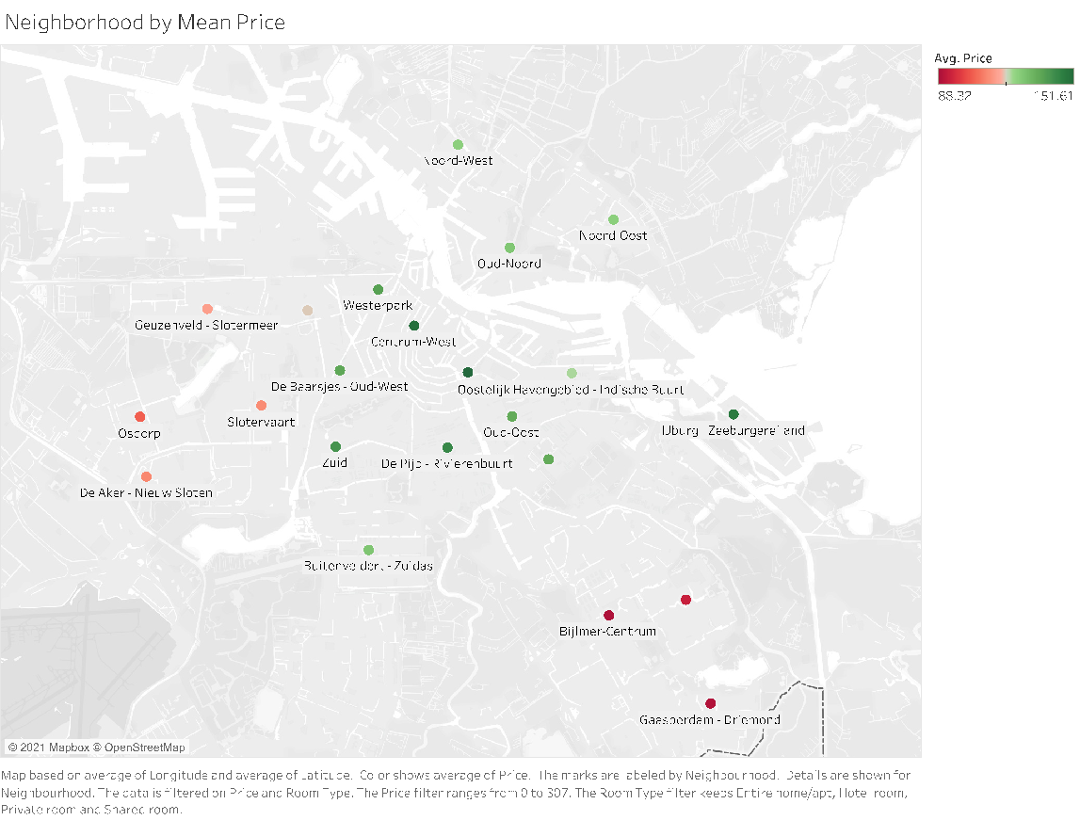
Neighborhoods with higher safety score seem to have higher mean price
Notes:
Neighborhoods which are either centrally located or have a high safety score seem to have a higher mean price!!
There are few exceptions to it like Noord-Oost, Oud-Noord

Slide 14
Potential Illegal Listings
When renting out Private rooms, owners cannot rent out more than 40% of the total space (in sq. meters)
Notes:
Amsterdam has placed a lot of rules on Airbnbs to control the tourists such as limit on maximum guests, short terms rental durations, etc.

Slide 15
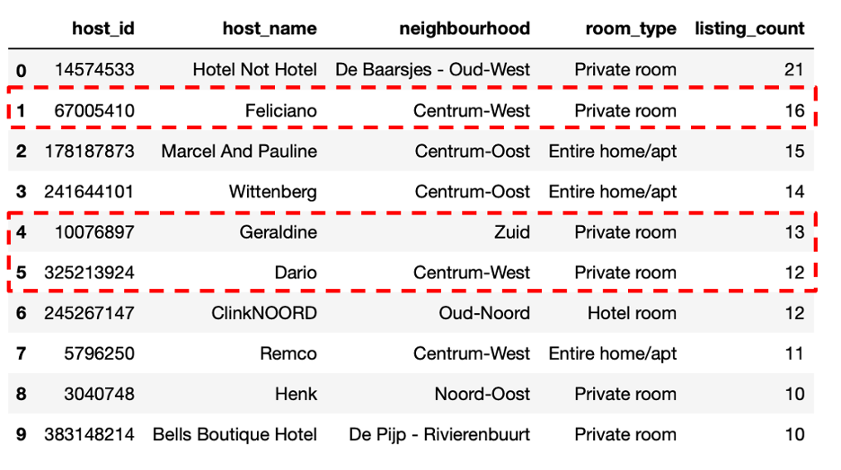
Potential illegal listings on Amsterdam Airbnb

Slide 16
MODELING

Slide 17
k - nearest neighbors
Notes:
Amsterdam has placed a lot of rules on Airbnbs to control the tourists such as limit on maximum guests, short terms rental durations, etc.

Slide 18
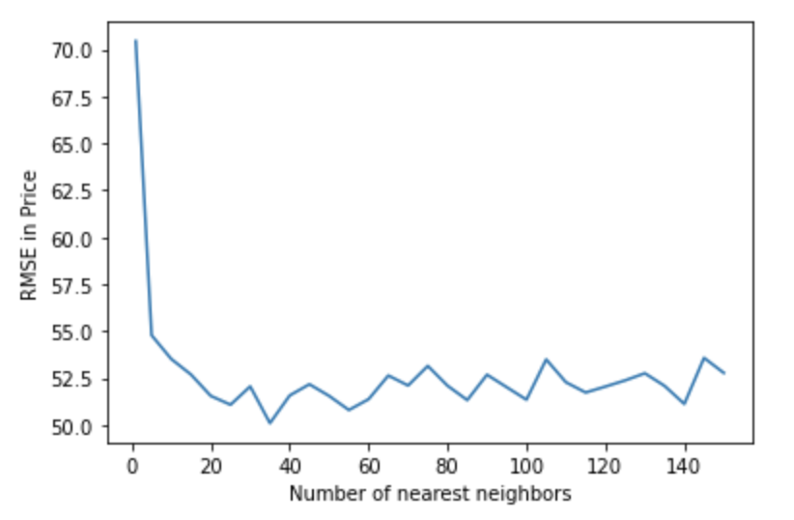
Running a k-fold cross validation yields least Price RMSE of 50.1 at k = 35
Predictors used for modeling :
Neighborhood
Room Type
Latitude
Longitude

Slide 19
Random Forests
Notes:
Amsterdam has placed a lot of rules on Airbnbs to control the tourists such as limit on maximum guests, short terms rental durations, etc.

Slide 20
Random Forest yields a RMSE score of 52 for Entire Apt and 42 for Private Room
Important Predictors
Key Model Features
Remarks
Longitude
Latitude
Number of reviews
availability_365
Minimum nights
Entire Home/Apt
Train RMSE - 50
Test RMSE - 52
Private Room
Train RMSE - 39
Test RMSE - 42
- The prediction is better for private room type than entire apartment/house
- The model is under estimating at higher prices and over estimating at lower prices

Slide 21
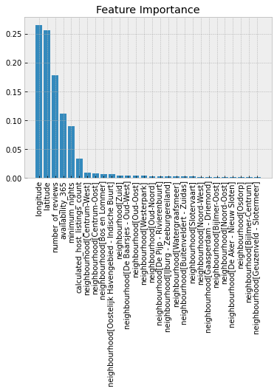
Important Predictors

Slide 22
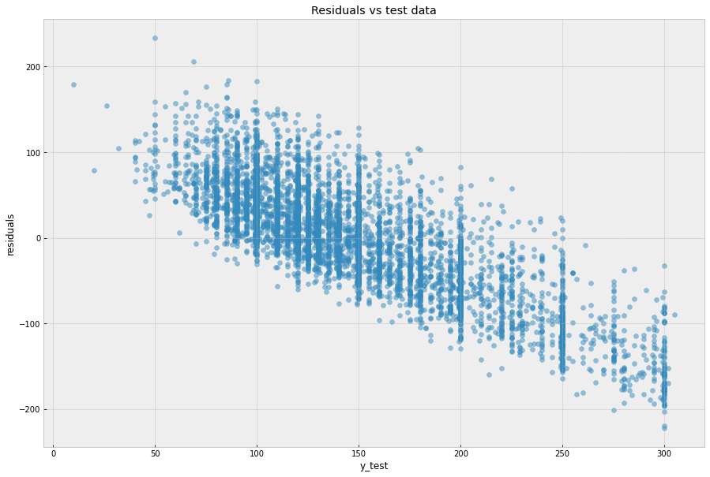
Plot of Residual error Vs Prices

Slide 23
Linear Regression
Notes:
Amsterdam has placed a lot of rules on Airbnbs to control the tourists such as limit on maximum guests, short terms rental durations, etc.

Slide 24
Linear Regression yields a RMSE score of 51.5
Important Predictors
Key Model Features
Remarks
Room Type
Neighbourhood
Number of reviews
Minimum nights
Train RMSE - 51.51
Test RMSE - 51.53
Cross Validation RMSE - 51.53
- Higher the minimum nights, lesser the price
- The prices are very low for shared rooms
- Neighbourhood centrum west has higher prices

Slide 25
Ridge Regression
Notes:
Amsterdam has placed a lot of rules on Airbnbs to control the tourists such as limit on maximum guests, short terms rental durations, etc.

Slide 26
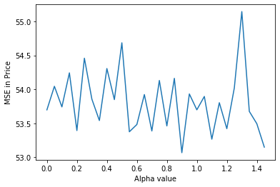
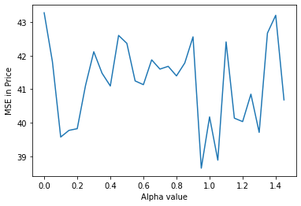
Ridge Regression yields a RMSE score of 53 for Entire Apt and 42 for Private Room
Important Predictors
Key Model Features
Remarks
Entire Home / Apt
Split the model based on room type
Neighbourhood
Number of reviews
Minimum nights
Entire Home/Apt
Train RMSE - 53.68
Test RMSE - 54.02
Cross Validation RMSE - 53.07 (alpha = 0.89)
Private Room
Train RMSE - 39.96
Test RMSE - 42.55
Cross Validation RMSE - 38.64 (alpha = 0.95)
Private Room
- Provide a grid for alpha values
- Choose the model with least cross validation rmse
- Repeat the same for entire home/apt and private room

Slide 27
BUSINESS IMPACT

Slide 28
Modeling Business Impact
Metric | Calculation
Predicted price of the listing | x = y_pred - RMSE (removing RMSE for conservative approach)
$x aggregated for listings with their actual price < x (potentially underpriced listings) | $11,865 (underpriced listings in test data - revenue)
# Potentially underpriced listings | 654 (unique low priced listings in test data)
Profit per underpriced listing per day | $18.14
Average occupancy days per underpriced listing per month | 18 (from average reviews per month and minimum nights)
Average occupancy days per underpriced listing per year | 216
Profit per year per underpriced listing | $3919 (occupancy days per year * profit per listing)
Assuming 50 % is the true profit | $1959 (Removing some additional costs)
The model drives ~$2000 per year per listing if prices are optimized

Slide 29
QUESTIONS?

